Slide 1
Computer vision: models, learning and inference
Chapter 7
Modeling Complex Densities

Slide 2
Structure
Densities for classification
Models with hidden variables
Mixture of Gaussians
t-distributions
Factor analysis
EM algorithm in detail
Applications
Computer vision: models, learning and inference. ©2011 Simon J.D. Prince
2

Slide 3
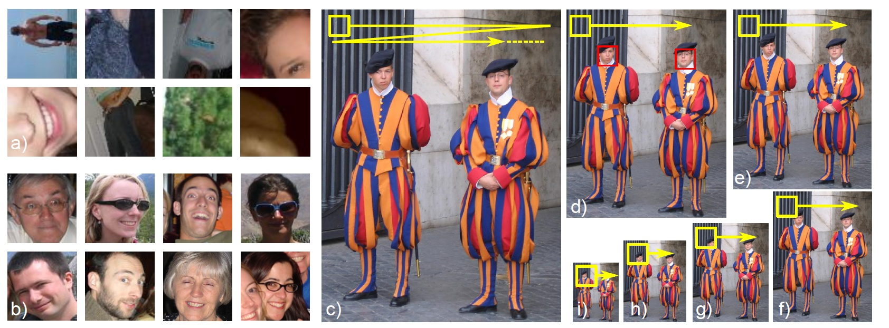
Face Detection
Computer vision: models, learning and inference. ©2011 Simon J.D. Prince
3

Slide 4
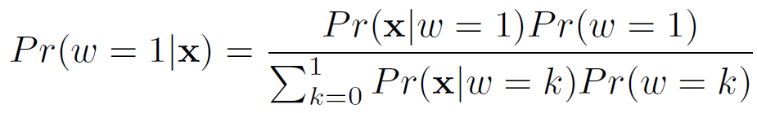
Type 3: Pr(x|w) - Generative
How to model Pr(x|w)?
Choose an appropriate form for Pr(x)
Make parameters a function of w
Function takes parameters θ that define its shape
Learning algorithm: learn parameters θ from training data x,w
Inference algorithm: Define prior Pr(w) and then compute Pr(w|x) using Bayes’ rule
Computer vision: models, learning and inference. ©2011 Simon J.D. Prince
4

Slide 5
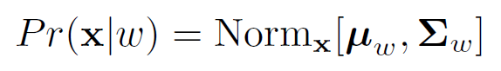
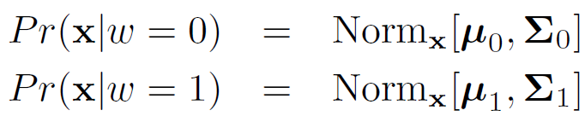
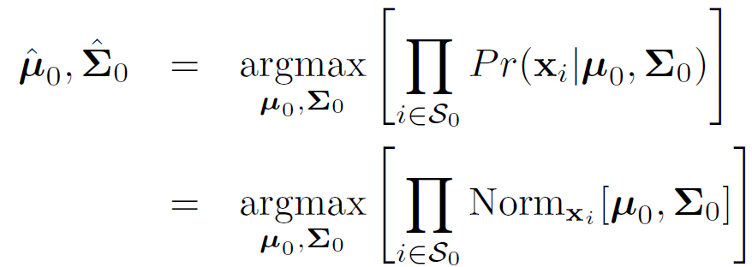





Classification Model
Or writing in terms of class conditional density functions
Parameters μ₀, Σ₀ learned just from data S₀ where w=0
Similarly, parameters μ₁, Σ₁ learned just from data S₁ where w=1
Computer vision: models, learning and inference. ©2011 Simon J.D. Prince
5

Slide 6
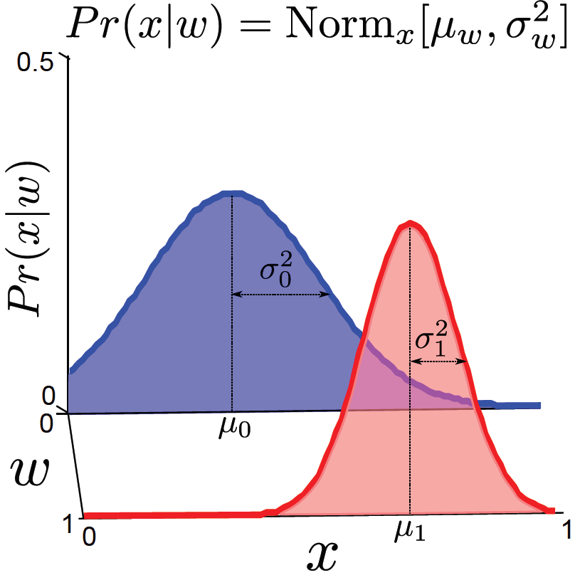
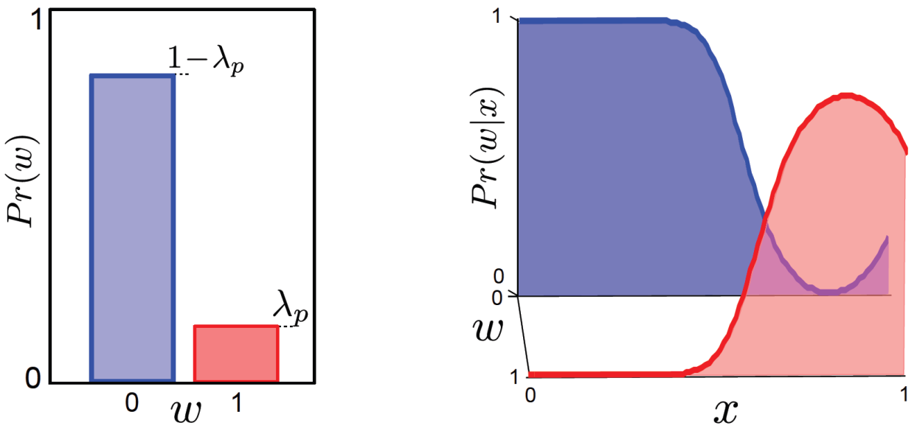

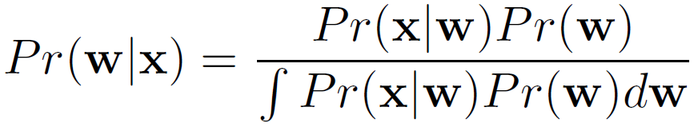

Inference algorithm: Define prior Pr(w) and then compute Pr(w|x) using Bayes’ rule

Slide 7
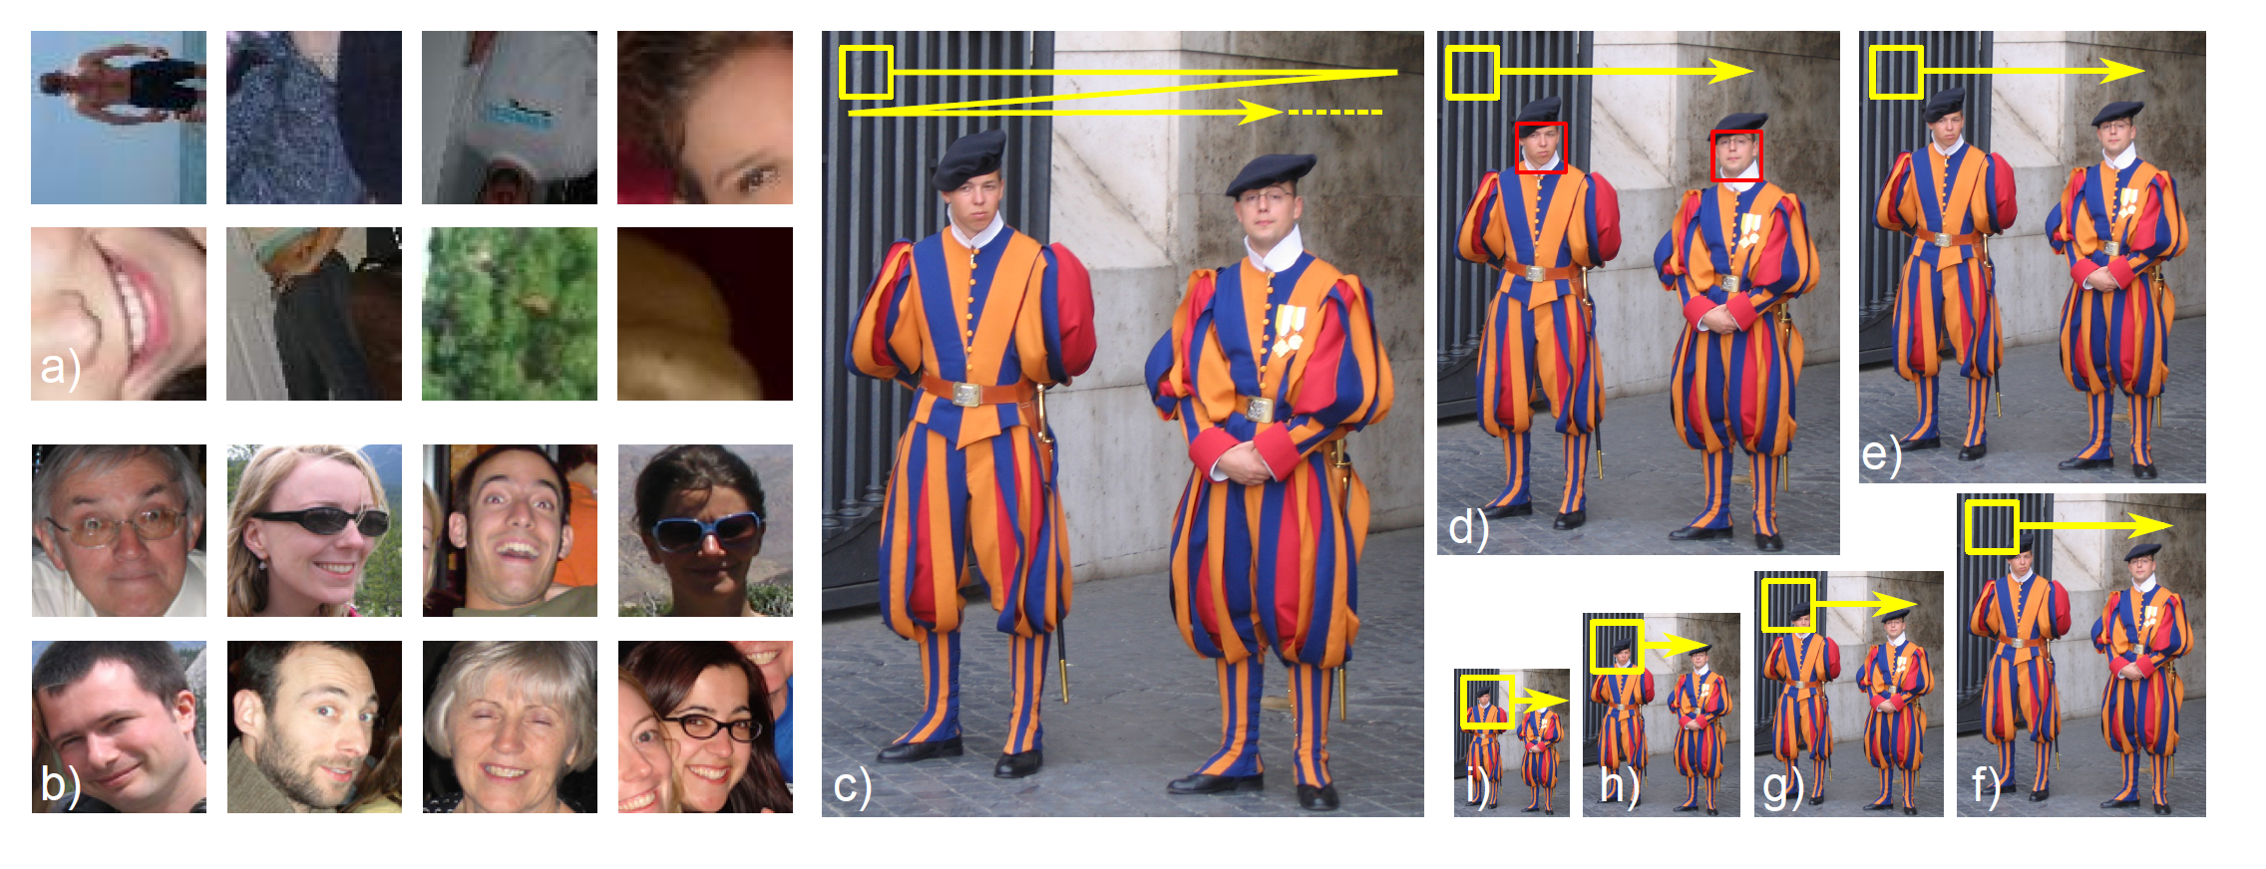
Experiment
1000 non-faces
1000 faces
60x60x3 Images =10800 x1 vectors
Equal priors Pr(w=1)=Pr(w=0) = 0.5
75% performance on test set. Not very good!
Computer vision: models, learning and inference. ©2011 Simon J.D. Prince
7

Slide 8
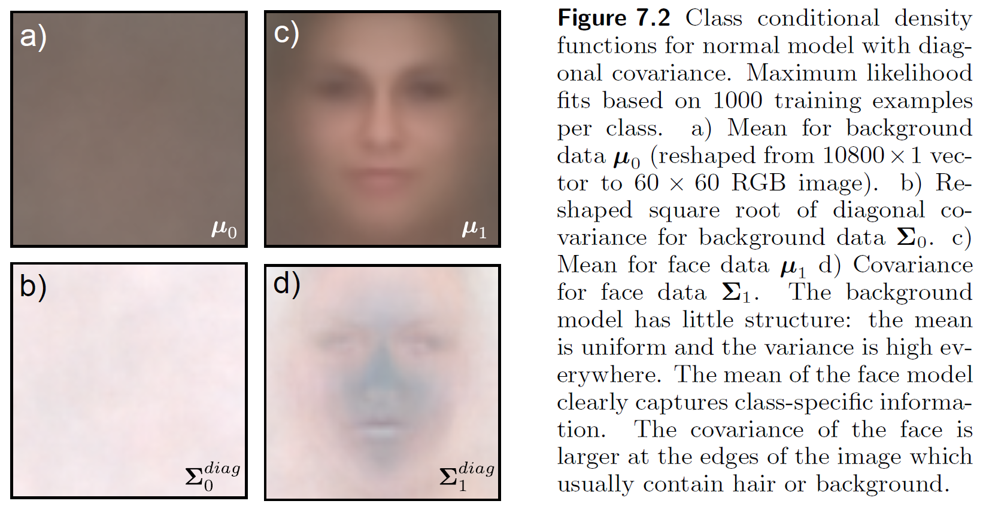
Results (diagonal covariance)
Computer vision: models, learning and inference. ©2011 Simon J.D. Prince
8

Slide 9
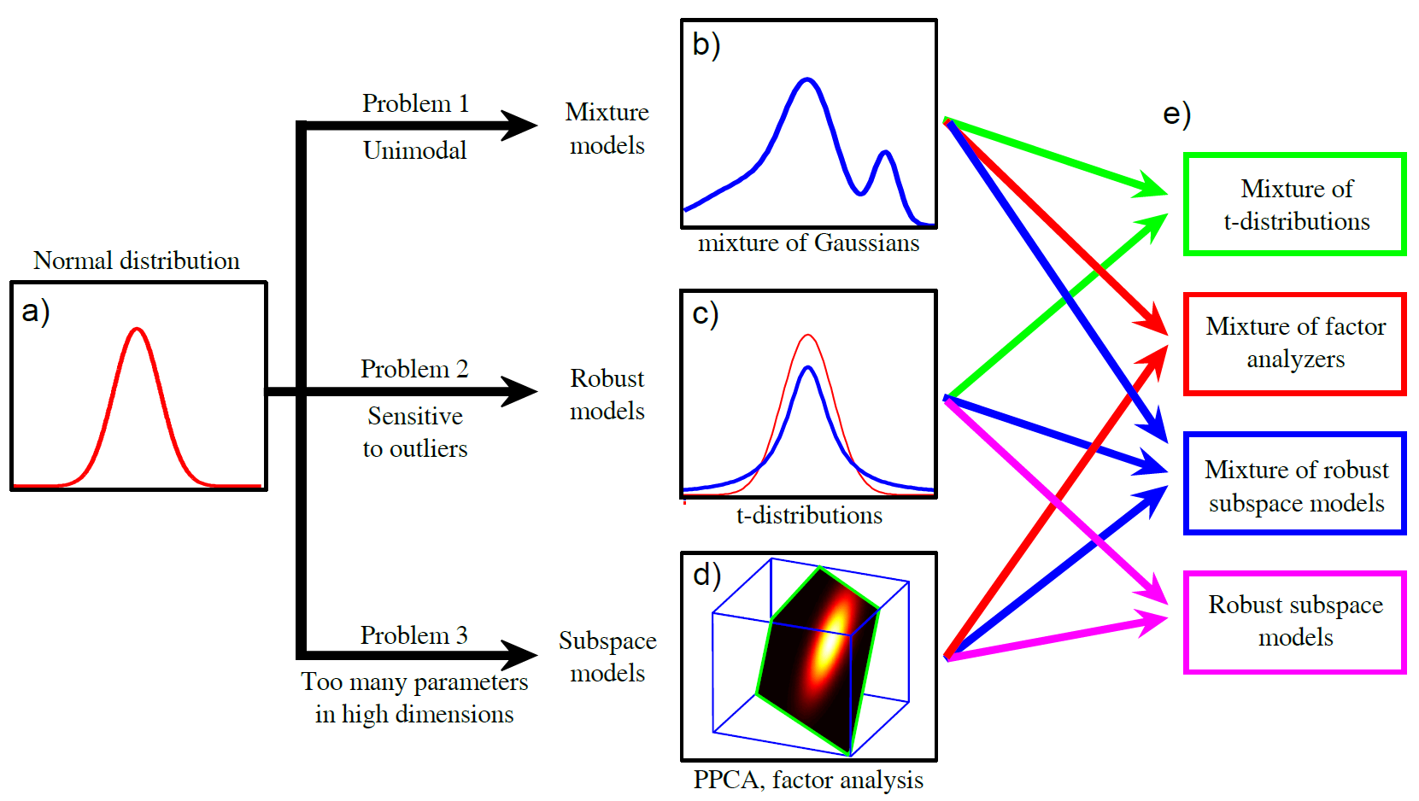
The plan...
Computer vision: models, learning and inference. ©2011 Simon J.D. Prince
9

Slide 10
Structure
Densities for classification
Models with hidden variables
Mixture of Gaussians
t-distributions
Factor analysis
EM algorithm in detail
Applications
Computer vision: models, learning and inference. ©2011 Simon J.D. Prince
10

Slide 11
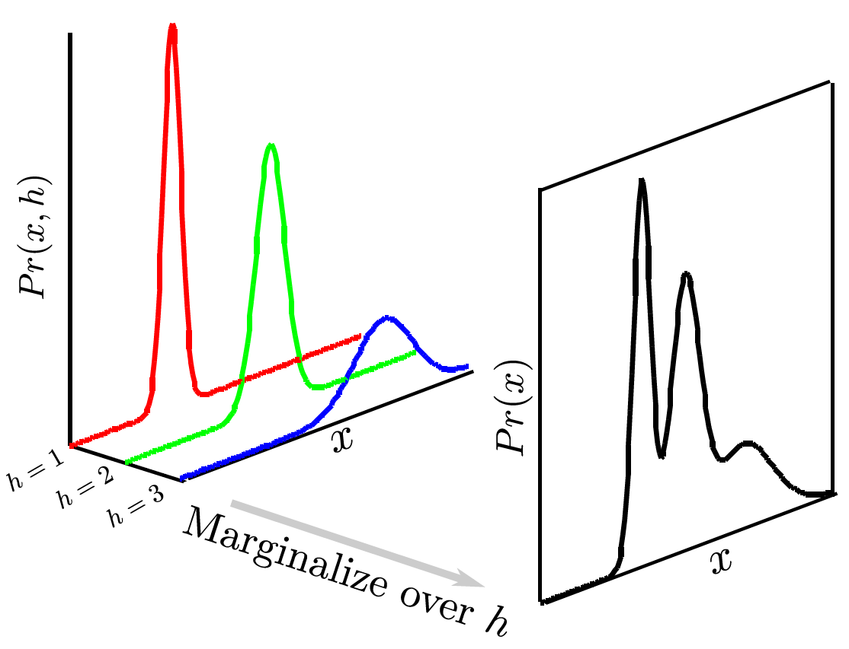
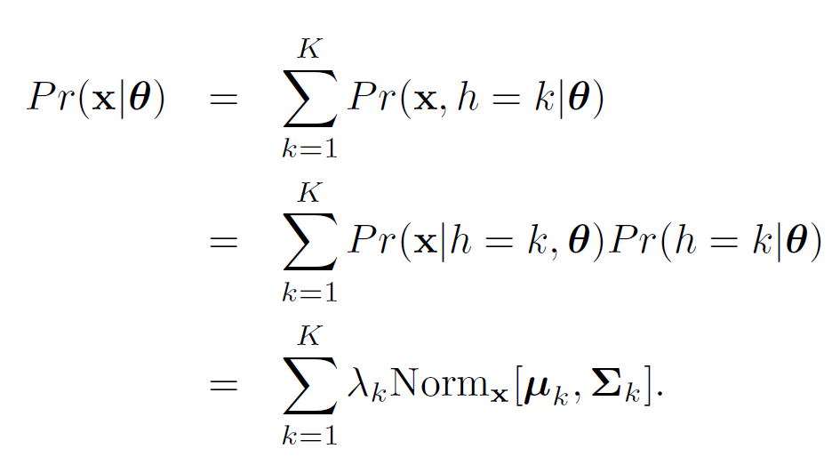


Example Objective: Mixture of Gaussians
Computer vision: models, learning and inference. ©2011 Simon J.D. Prince
11

Slide 12
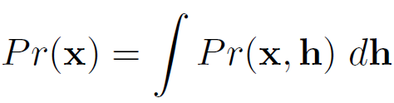
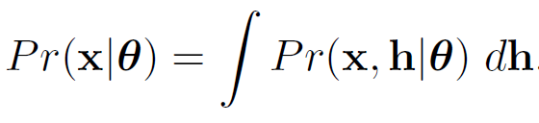
Hidden (or latent) Variables
Key idea: represent density Pr(x) as marginalization of joint density with another variable h that we do not see
Will also depend on some parameters:
Computer vision: models, learning and inference. ©2011 Simon J.D. Prince
12

Slide 13
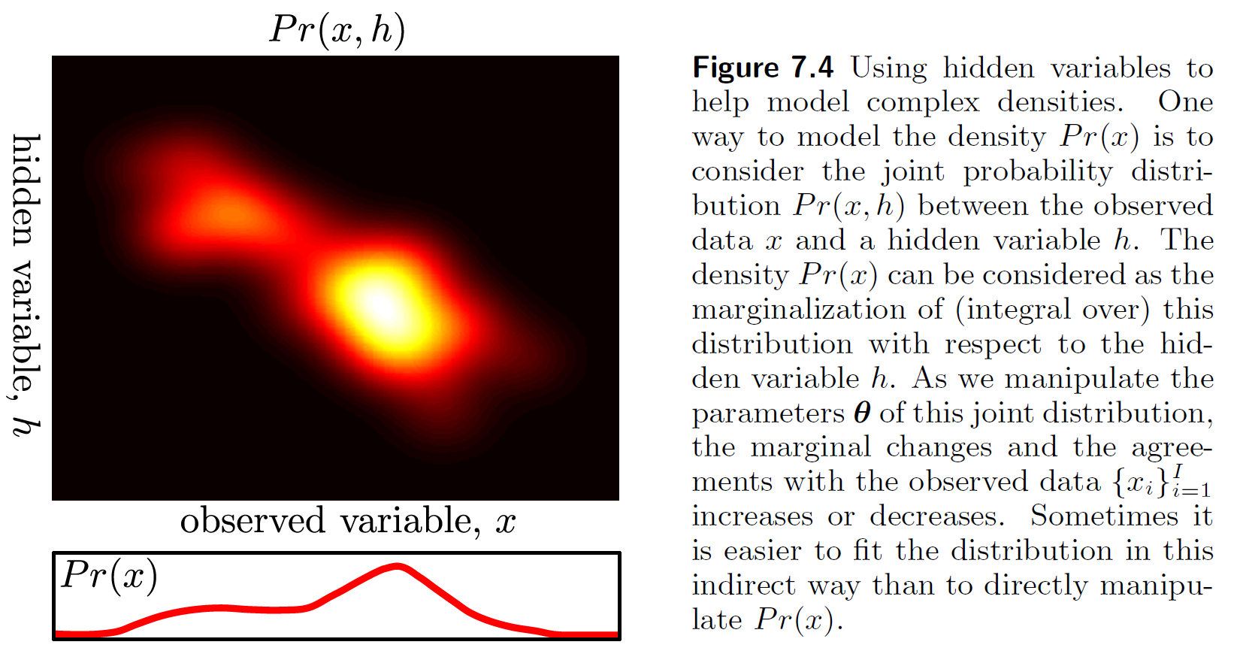





Hidden (or latent) Variables
Computer vision: models, learning and inference. ©2011 Simon J.D. Prince
13

Slide 14
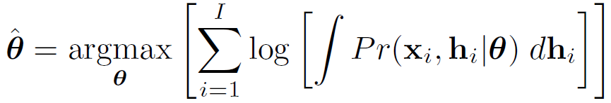
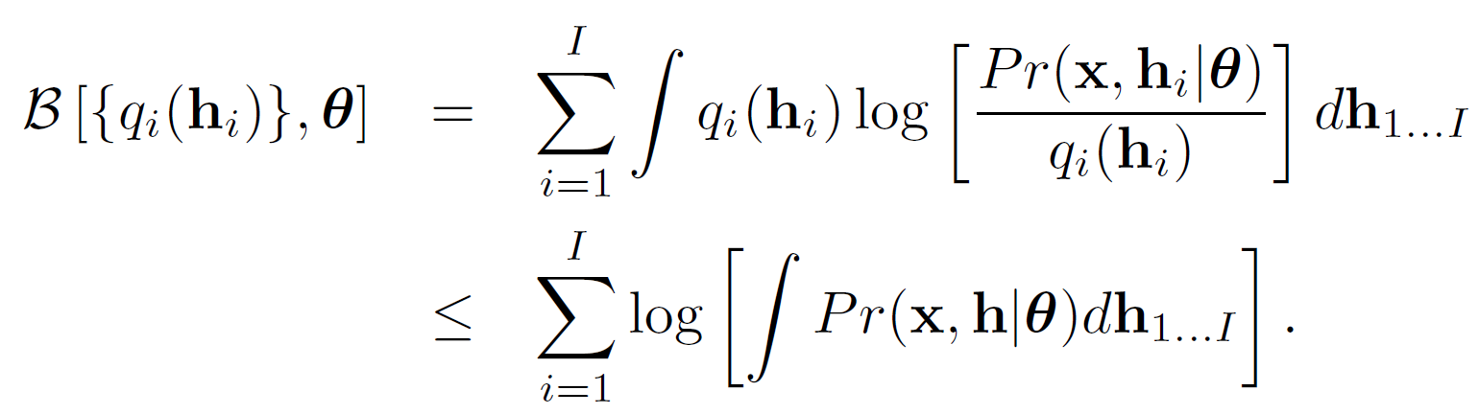







Expectation Maximization
An algorithm specialized to fitting pdfs which are the marginalization of a joint distribution
Defines a lower bound on log likelihood and increases bound iteratively
Computer vision: models, learning and inference. ©2011 Simon J.D. Prince
14

Slide 15



Lower bound
Lower bound is a function of parameters θ and a set of probability distributions q_{i}(h_{i})
Expectation Maximization (EM) algorithm alternates E-steps and M-Steps
E-Step – Maximize bound w.r.t. distributions q(h_{i})
M-Step – Maximize bound w.r.t. parameters θ
Computer vision: models, learning and inference. ©2011 Simon J.D. Prince
15

Slide 16
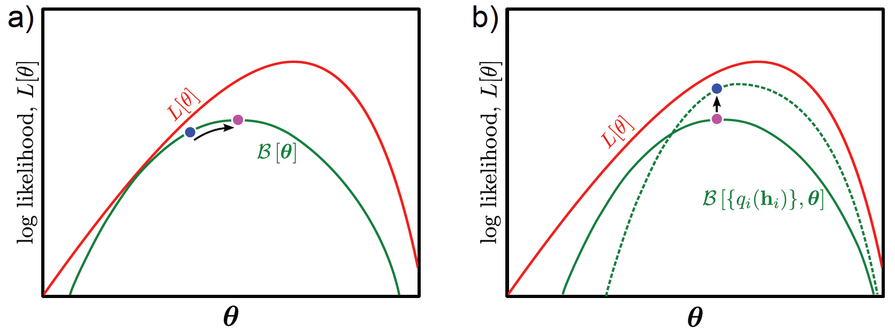



Lower bound
Computer vision: models, learning and inference. ©2011 Simon J.D. Prince
16

Slide 17
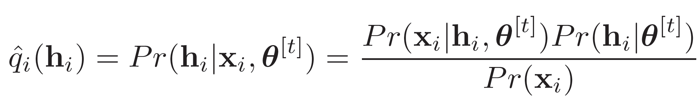
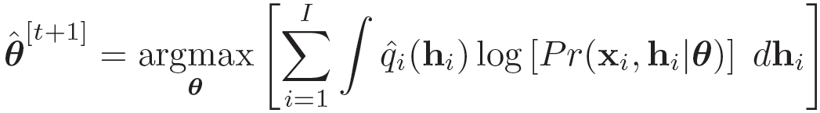

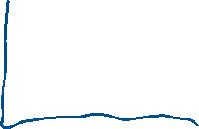
E-Step & M-Step
E-Step – Maximize bound w.r.t. distributions q_{i}(h_{i})
M-Step – Maximize bound w.r.t. parameters θ
Computer vision: models, learning and inference. ©2011 Simon J.D. Prince
17

Slide 18
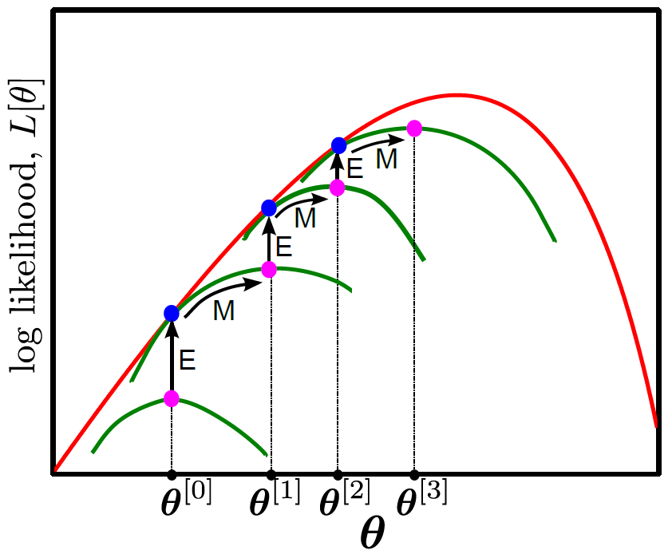

E-Step & M-Step
Computer vision: models, learning and inference. ©2011 Simon J.D. Prince
18

Slide 19
Structure
Densities for classification
Models with hidden variables
Mixture of Gaussians
t-distributions
Factor analysis
EM algorithm in detail
Applications
Computer vision: models, learning and inference. ©2011 Simon J.D. Prince
19

Slide 20
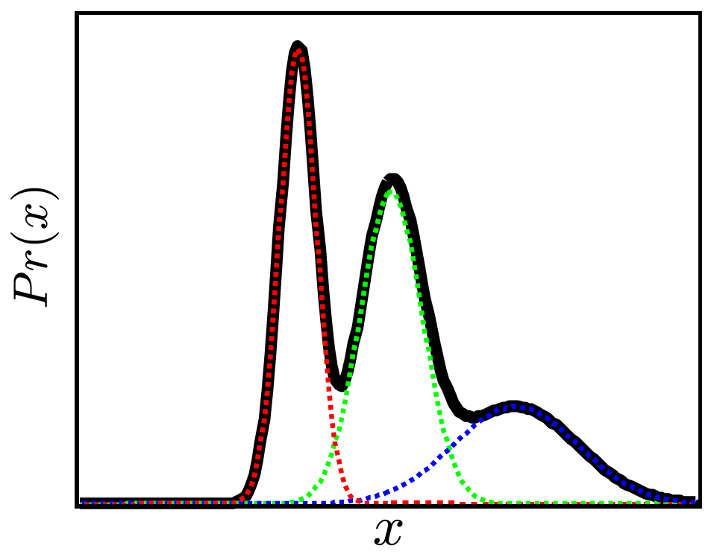
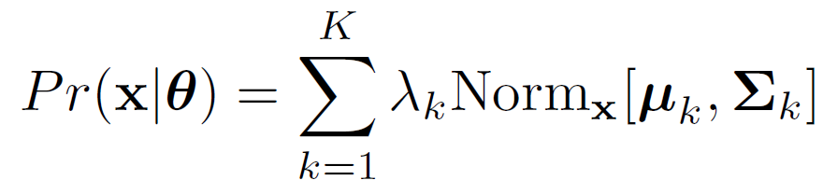
Mixture of Gaussians (MoG)
Computer vision: models, learning and inference. ©2011 Simon J.D. Prince
20

Slide 21
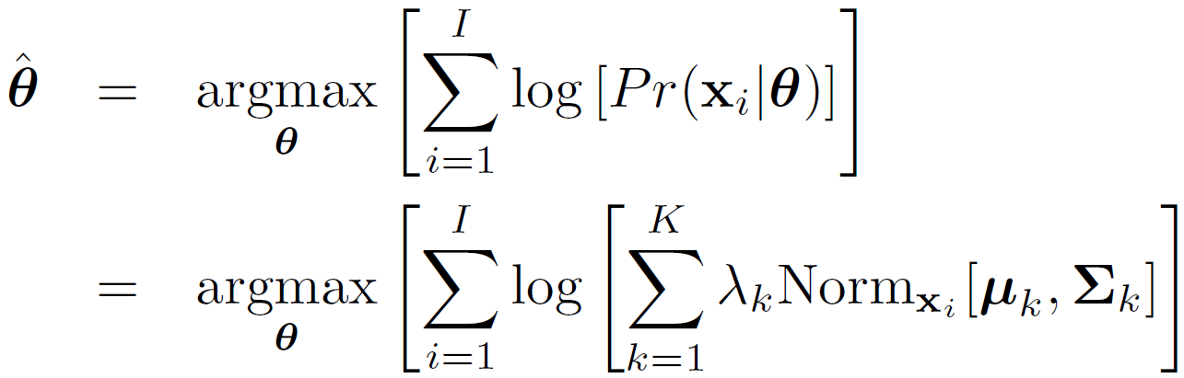
ML Learning
Q. Can we learn this model with maximum likelihood?
Yes, but using brute force approach is tricky
If you take derivative and set to zero, can’t solve
-- the log of the sum causes problems
Have to enforce constraints on parameters
covariances must be positive definite
weights must sum to one
Computer vision: models, learning and inference. ©2011 Simon J.D. Prince
21

Slide 22
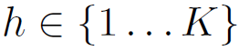
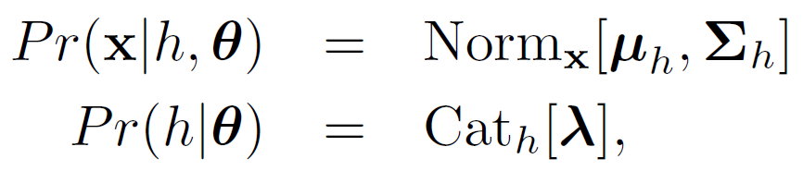
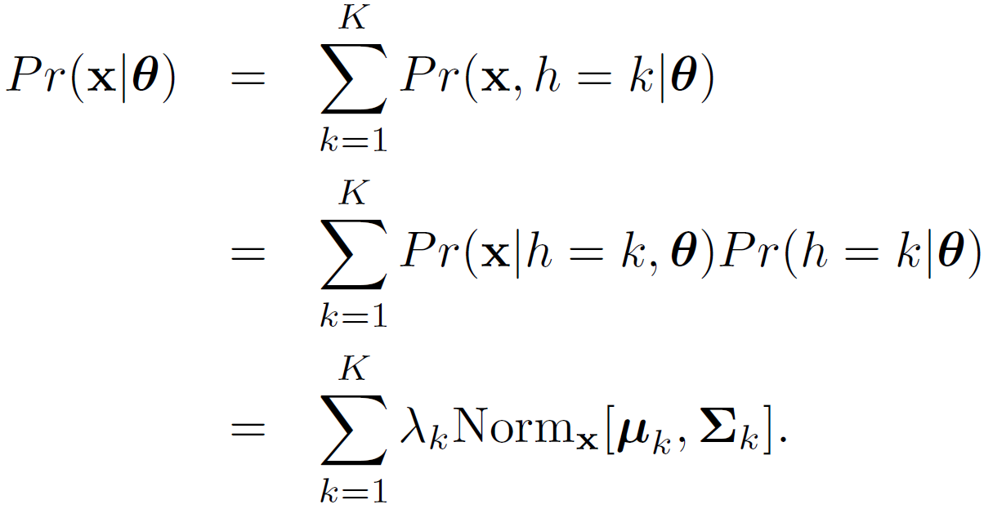


MoG as a marginalization
Define a variable and then write
Then we can recover the density by marginalizing Pr(x,h)
Computer vision: models, learning and inference. ©2011 Simon J.D. Prince
22

Slide 23

MoG as a marginalization
Computer vision: models, learning and inference. ©2011 Simon J.D. Prince
23

Slide 24
MoG as a marginalization
Define a variable and then write
Note :
This gives us a method to generate data from MoG
First sample Pr(h), then sample Pr(x|h)
The hidden variable h has a clear interpretation –
it tells you which Gaussian created data point x
Computer vision: models, learning and inference. ©2011 Simon J.D. Prince
24

Slide 25
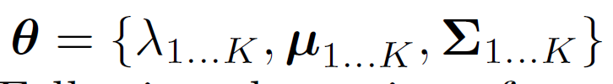
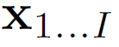
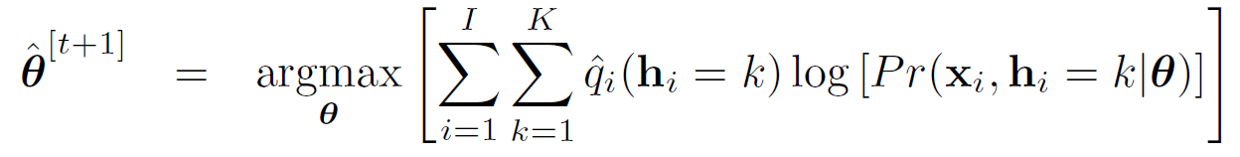

Expectation Maximization for MoG
GOAL: to learn parameters from
training data
E-Step – Maximize bound w.r.t. distributions q(h_{i})
M-Step – Maximize bound w.r.t. parameters θ
Computer vision: models, learning and inference. ©2011 Simon J.D. Prince
25

Slide 26
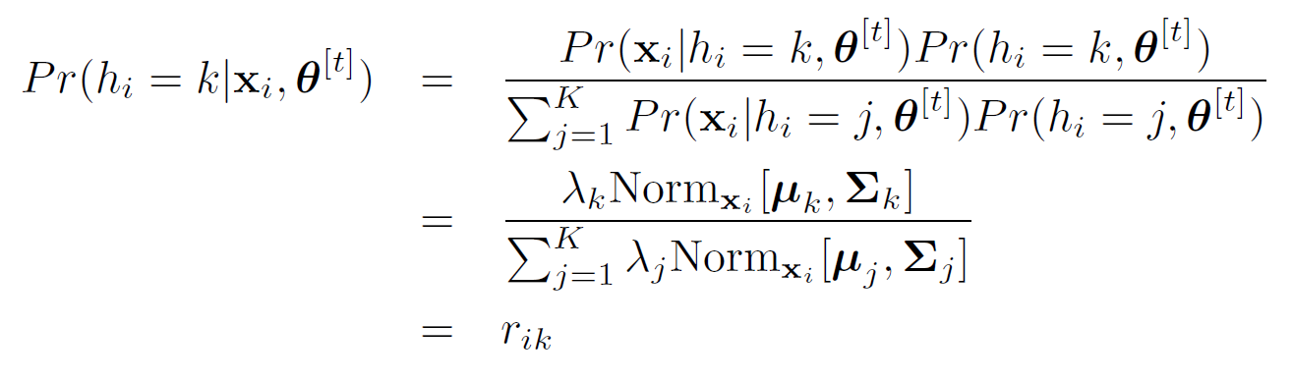
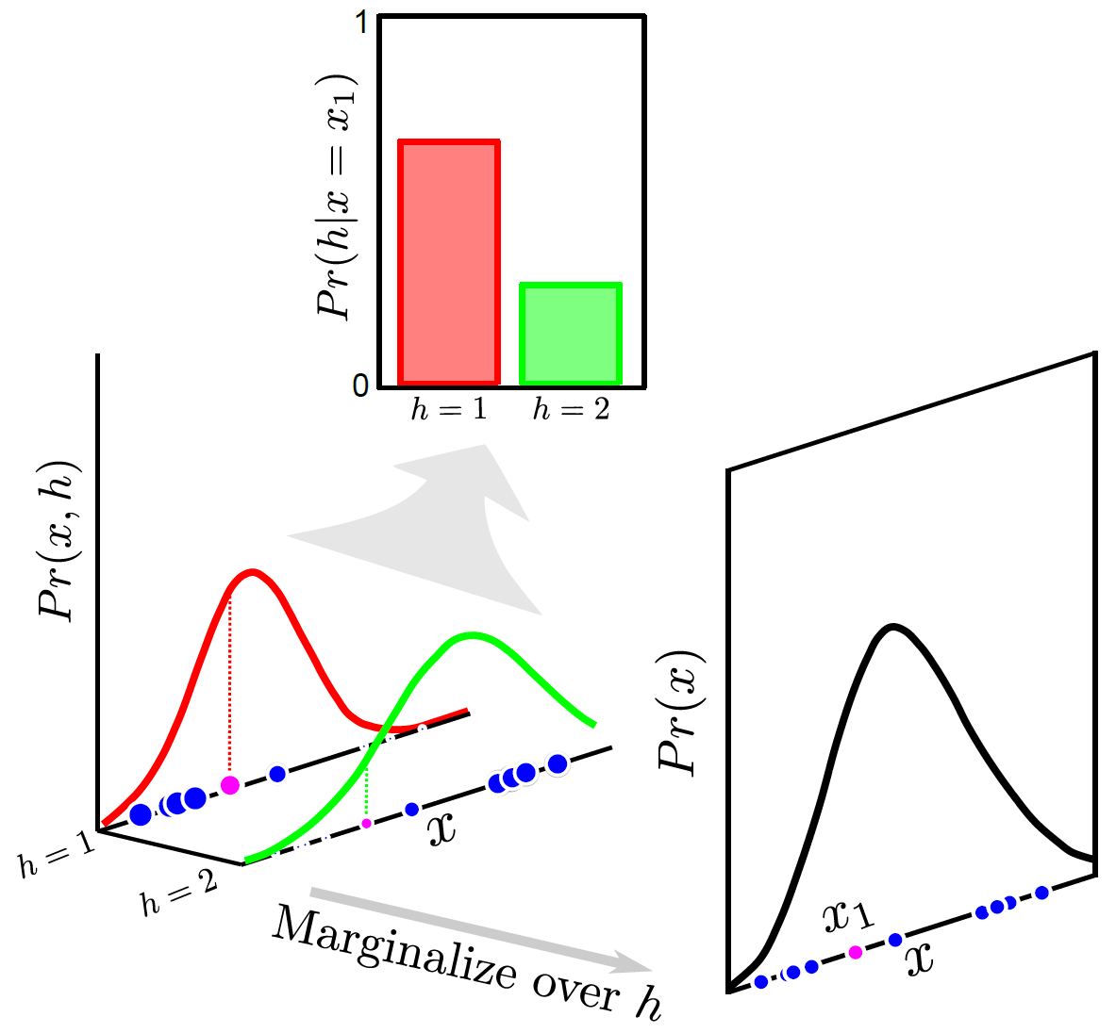



E-Step
We’ll call this the responsibility of the
k^{th} Gaussian for the i^{th} data point
Repeat this procedure for every datapoint!
Computer vision: models, learning and inference. ©2011 Simon J.D. Prince
26

Slide 27
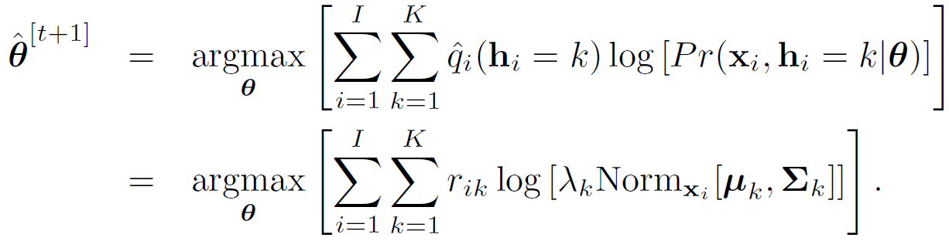
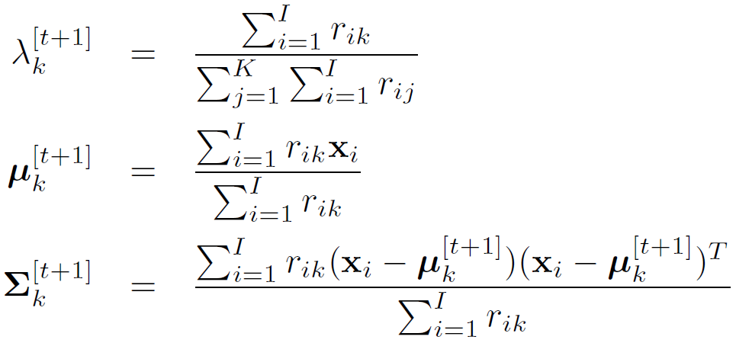



M-Step
Take derivative, equate to zero and solve (Lagrange multipliers for λ)
Computer vision: models, learning and inference. ©2011 Simon J.D. Prince
27

Slide 28
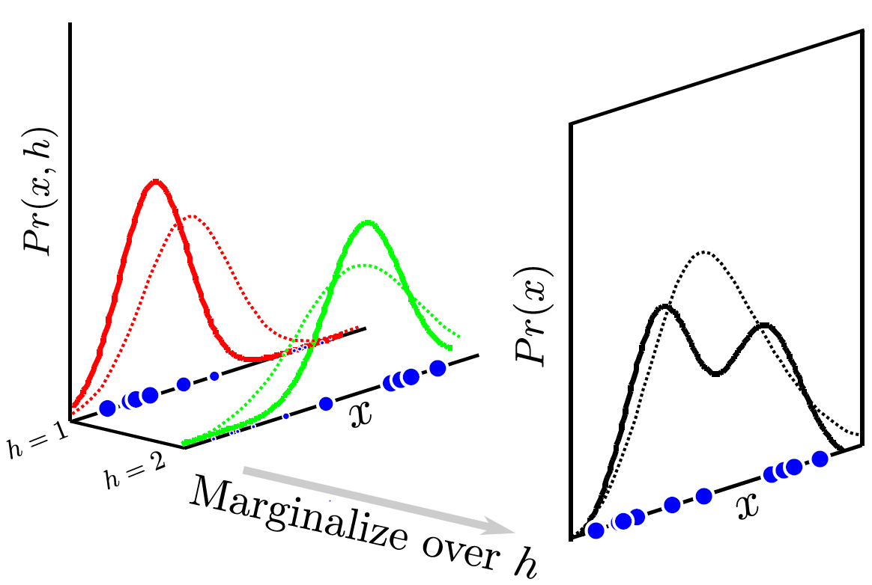
M-Step
Update means , covariances and weights according to responsibilities of datapoints
Computer vision: models, learning and inference. ©2011 Simon J.D. Prince
28

Slide 29
Iterate until no further improvement
E-Step
M-Step
Computer vision: models, learning and inference. ©2011 Simon J.D. Prince
29

Slide 30
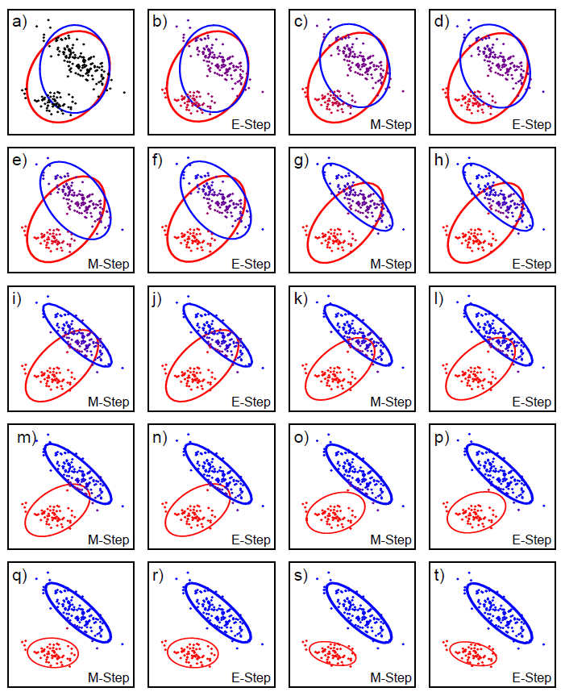
Computer vision: models, learning and inference. ©2011 Simon J.D. Prince
30

Slide 31
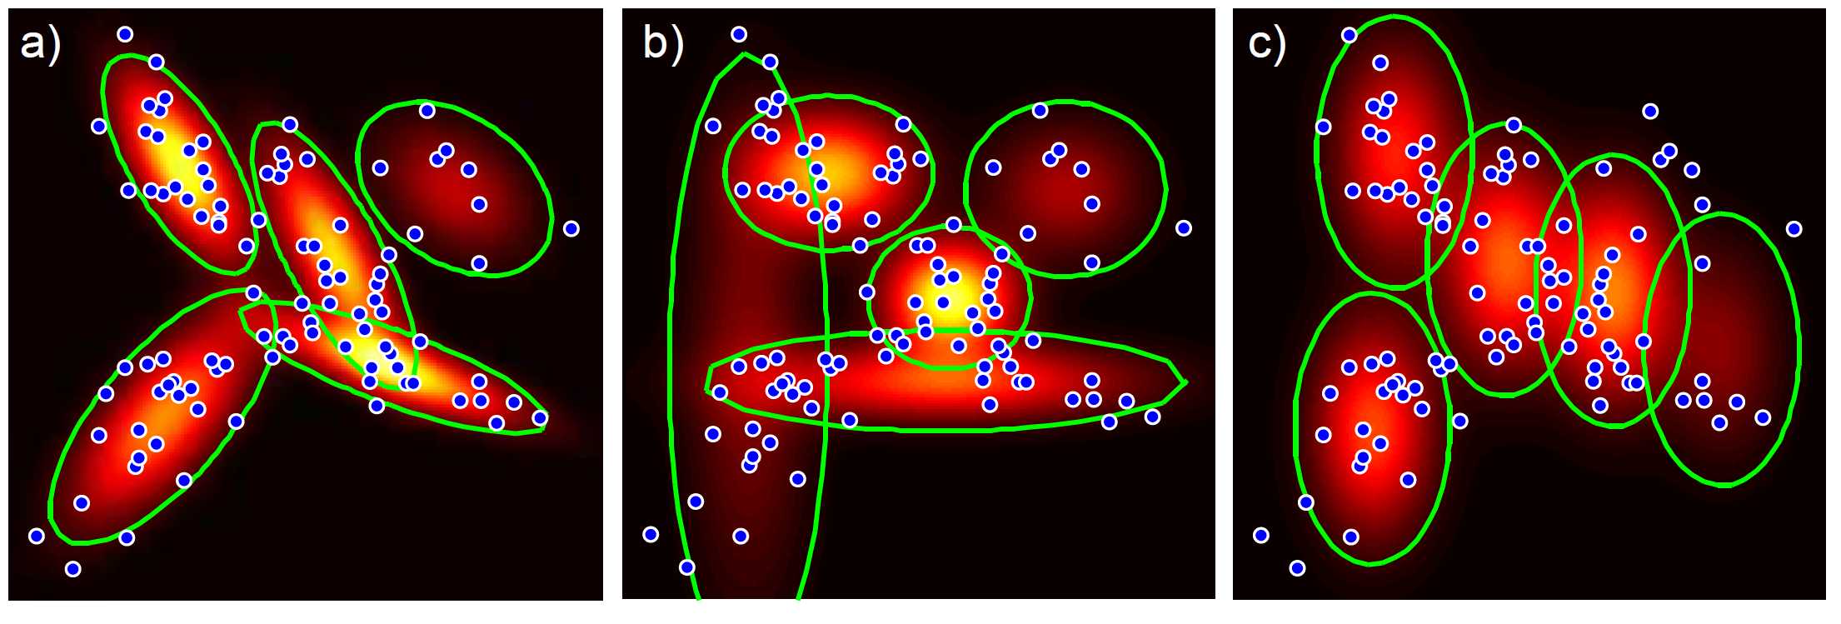
Different flavours...
Full
covariance
Diagonal
covariance
Same
covariance
Computer vision: models, learning and inference. ©2011 Simon J.D. Prince
31

Slide 32
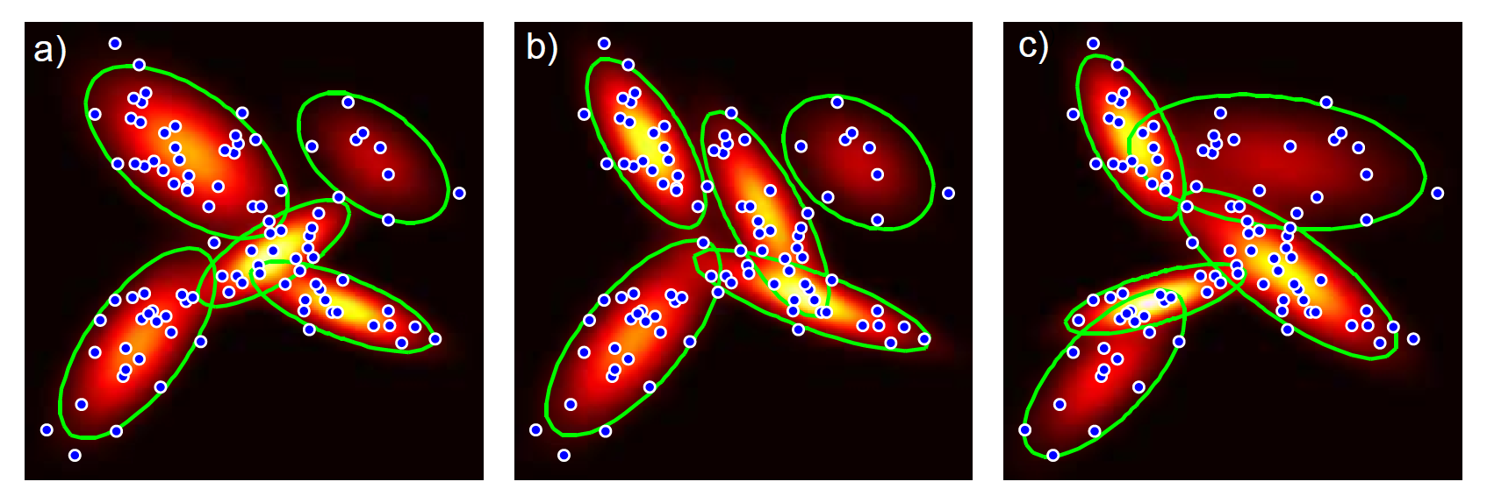
Local Minima
Start from three random positions
L = 98.76
L = 96.97
L = 94.35
Computer vision: models, learning and inference. ©2011 Simon J.D. Prince
32

Slide 33
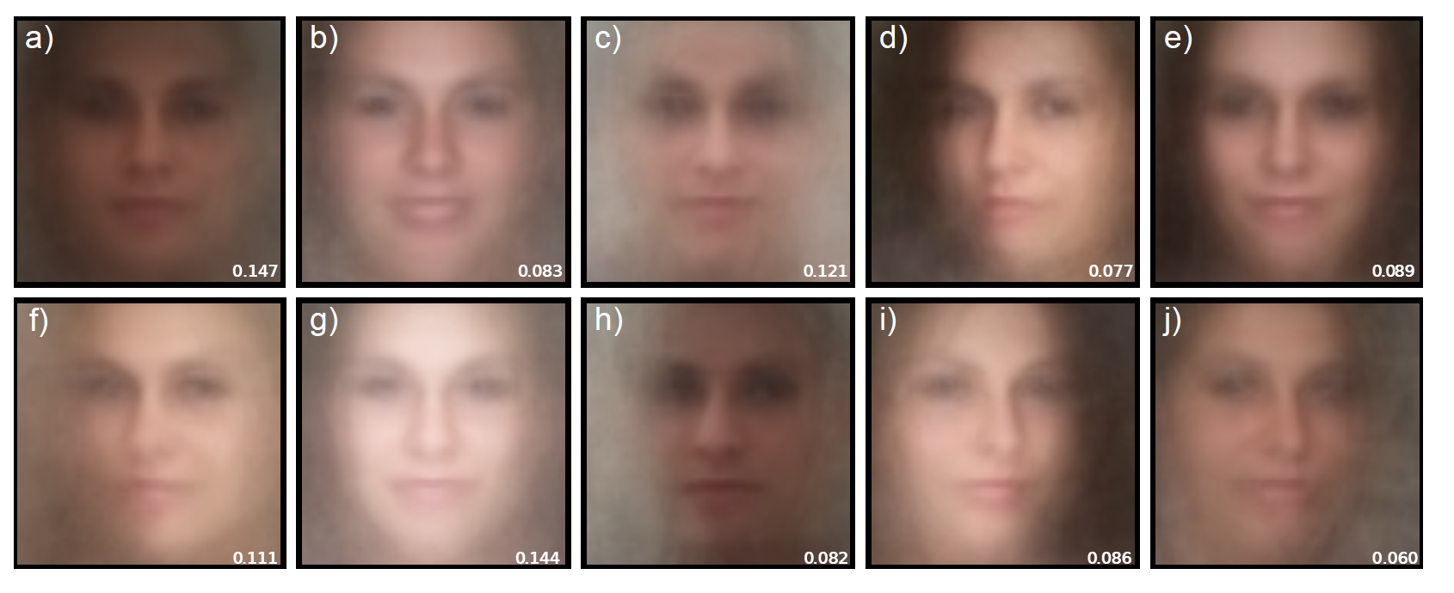
Means of face/non-face model
Classification → 84% (9% improvement!)
Computer vision: models, learning and inference. ©2011 Simon J.D. Prince
33

Slide 34
The plan...
Computer vision: models, learning and inference. ©2011 Simon J.D. Prince
34

Slide 35
Structure
Densities for classification
Models with hidden variables
Mixture of Gaussians
t-distributions
Factor analysis
EM algorithm in detail
Applications
Computer vision: models, learning and inference. ©2011 Simon J.D. Prince
35

Slide 36
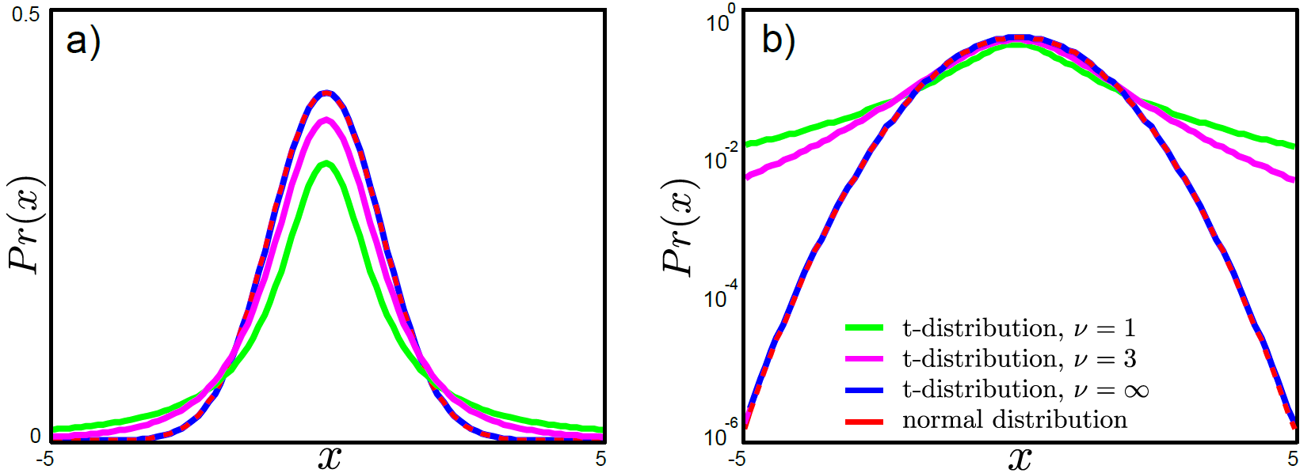
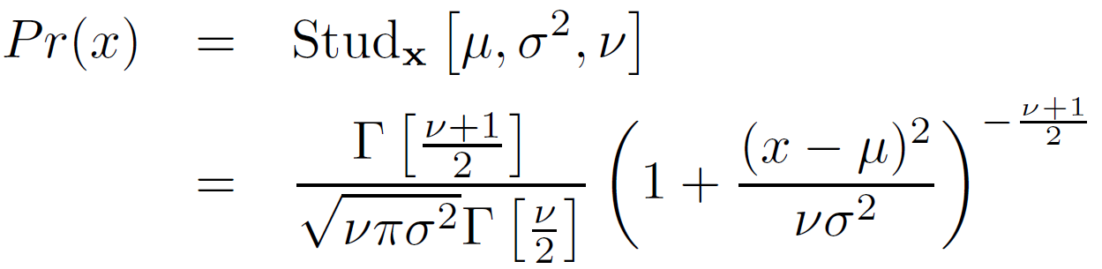








Student t-distributions
Computer vision: models, learning and inference. ©2011 Simon J.D. Prince
36

Slide 37
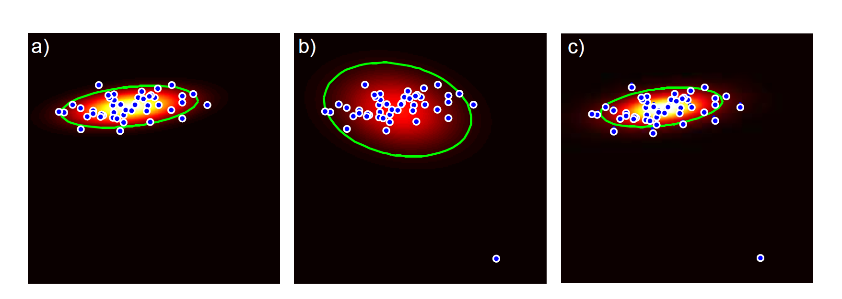
Student t-distributions motivation
The normal distribution is not very robust – a single outlier can completely throw it off because the tails fall off so fast...
Normal distribution
Normal distribution
w/ one extra datapoint!
t-distribution
Normal distribution
Normal distribution
w/ one extra datapoint!
t-distribution
Computer vision: models, learning and inference. ©2011 Simon J.D. Prince
37

Slide 38
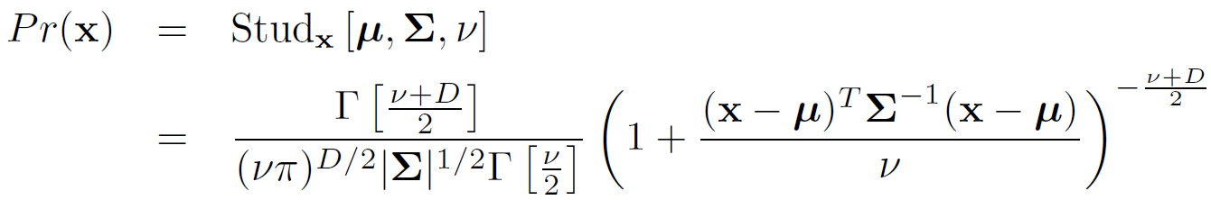
Student t-distributions
Univariate student t-distribution
Multivariate student t-distribution
Computer vision: models, learning and inference. ©2011 Simon J.D. Prince
38

Slide 39
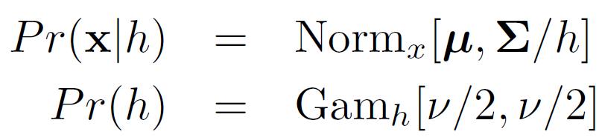
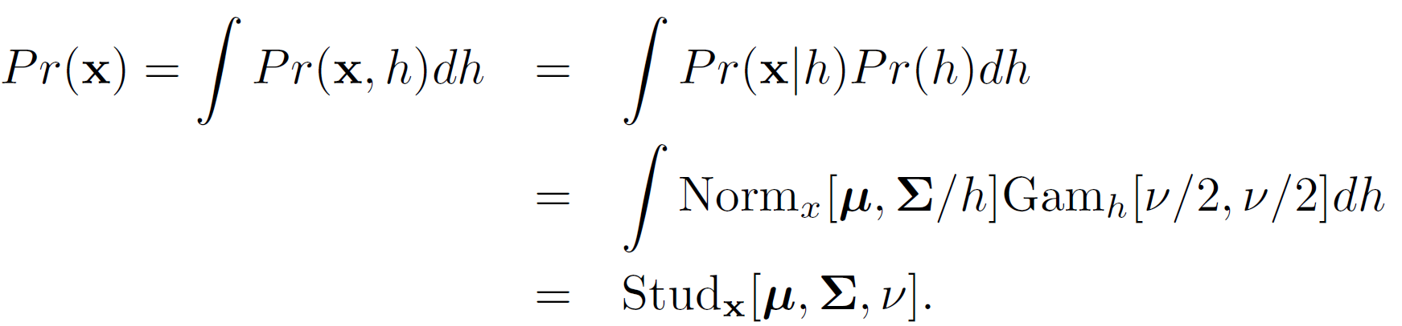

t-distribution as a marginalization
Define hidden variable h
Can be expressed as a marginalization
Computer vision: models, learning and inference. ©2011 Simon J.D. Prince
39

Slide 40
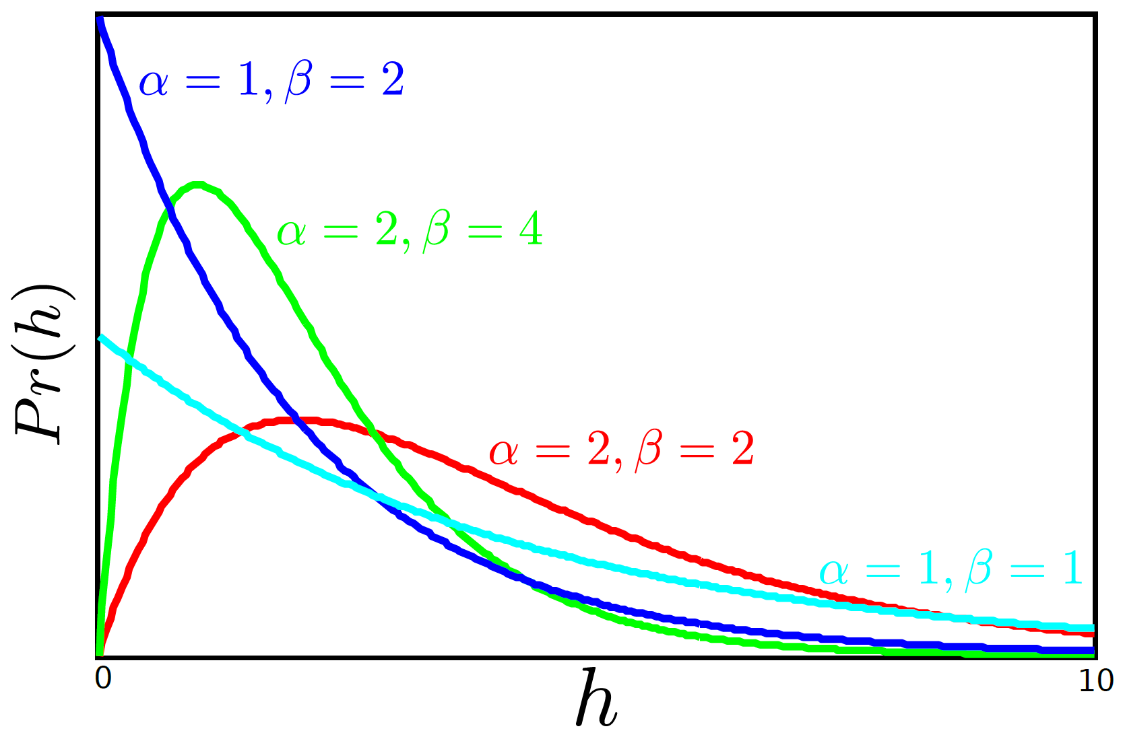
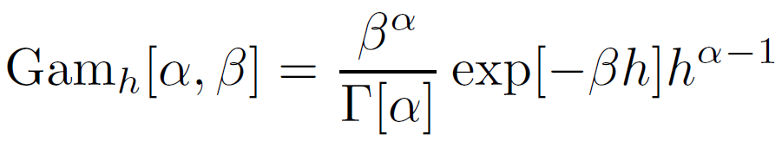
Gamma distribution
Computer vision: models, learning and inference. ©2011 Simon J.D. Prince
40

Slide 41


t-distribution as a marginalization
Define hidden variable h
Things to note:
Again this provides a method to sample from the t-distribution
Variable h has a clear interpretation:
Each datum drawn from a Gaussian, mean μ
Covariance depends inversely on h
Can think of this as an infinite mixture (sum becomes integral)
of Gaussians w/ same mean, but different variances
Computer vision: models, learning and inference. ©2011 Simon J.D. Prince
41

Slide 42
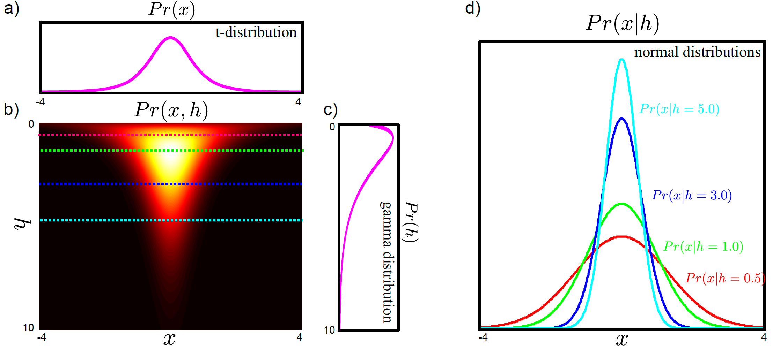







t-distribution
Computer vision: models, learning and inference. ©2011 Simon J.D. Prince
42

Slide 43



EM for t-distributions
GOAL: to learn parameters from training
data
E-Step – Maximize bound w.r.t. distributions q(h_{i})
M-Step – Maximize bound w.r.t. parameters θ
Computer vision: models, learning and inference. ©2011 Simon J.D. Prince
43

Slide 44



E-Step
Extract expectations
Computer vision: models, learning and inference. ©2011 Simon J.D. Prince
44

Slide 45


M-Step
Where...
Computer vision: models, learning and inference. ©2011 Simon J.D. Prince
45

Slide 46


Updates
No closed form solution for ν. Must optimize bound – since it is only one number we can optimize by just evaluating with a fine grid of values and picking the best
Computer vision: models, learning and inference. ©2011 Simon J.D. Prince
46

Slide 47

EM algorithm for t-distributions
Computer vision: models, learning and inference. ©2011 Simon J.D. Prince
47

Slide 48
The plan...
Computer vision: models, learning and inference. ©2011 Simon J.D. Prince
48

Slide 49
Structure
Densities for classification
Models with hidden variables
Mixture of Gaussians
t-distributions
Factor analysis
EM algorithm in detail
Applications
Computer vision: models, learning and inference. ©2011 Simon J.D. Prince
49

Slide 50




Factor Analysis
Compromise between
Full covariance matrix (desirable but many parameters)
Diagonal covariance matrix (no modelling of covariance)
Models full covariance in a subspace Φ
Mops everything else up with diagonal component Σ
Computer vision: models, learning and inference. ©2011 Simon J.D. Prince
50

Slide 51

Data Density
Consider modelling distribution of 100x100x3 RGB Images
Gaussian w/ spherical covariance: 1 covariance matrix parameters
Gaussian w/ diagonal covariance: D_{x} covariance matrix parameters
Full Gaussian: ~D_{x}² covariance matrix parameters
PPCA: ~D_{x} D_{h} covariance matrix parameters
Factor Analysis: ~D_{x} (D_{h}+1) covariance matrix parameters
Computer vision: models, learning and inference. ©2011 Simon J.D. Prince
51
(full covariance in subspace + diagonal)

Slide 52

Subspaces
Computer vision: models, learning and inference. ©2011 Simon J.D. Prince
52

Slide 53
Factor Analysis
Compromise between
Full covariance matrix (desirable but many parameters)
Diagonal covariance matrix (no modelling of covariance)
Models full covariance in a subspace Φ
Mops everything else up with diagonal component Σ
Computer vision: models, learning and inference. ©2011 Simon J.D. Prince
53

Slide 54


Factor Analysis as a Marginalization
Let’s define
Then it can be shown (not obvious) that
Computer vision: models, learning and inference. ©2011 Simon J.D. Prince
54

Slide 55



Sampling from factor analyzer
Computer vision: models, learning and inference. ©2011 Simon J.D. Prince
55

Slide 56


Factor analysis vs. MoG
Computer vision: models, learning and inference. ©2011 Simon J.D. Prince
56

Slide 57


E-Step
Compute posterior over hidden variables
Compute expectations needed for M-Step
Computer vision: models, learning and inference. ©2011 Simon J.D. Prince
57

Slide 58

E-Step
Computer vision: models, learning and inference. ©2011 Simon J.D. Prince
58

Slide 59


M-Step
Optimize parameters w.r.t. EM bound
where....
Computer vision: models, learning and inference. ©2011 Simon J.D. Prince
59

Slide 60

M-Step
Optimize parameters w.r.t. EM bound
where...
giving expressions:
Computer vision: models, learning and inference. ©2011 Simon J.D. Prince
60

Slide 61

Face model
Computer vision: models, learning and inference. ©2011 Simon J.D. Prince
61

Slide 62
Sampling from 10 parameter model
To generate:
Choose factor loadings, h_{i} from standard normal distribution
Multiply by factors, Φ
Add mean, μ
(should add random noise component ε_{i} w/ diagonal cov Σ)
Computer vision: models, learning and inference. ©2011 Simon J.D. Prince
62

Slide 63

Combining Models
Can combine three models in various combinations
Mixture of t-distributions = mixture of Gaussians + t-distributions
Robust subspace models = t-distributions + factor analysis
Mixture of factor analyizers = mixture of Gaussians + factor analysis
Or combine all models to create mixture of robust subspace models
Computer vision: models, learning and inference. ©2011 Simon J.D. Prince
63

Slide 64
Structure
Densities for classification
Models with hidden variables
Mixture of Gaussians
t-distributions
Factor analysis
EM algorithm in detail
Applications
Computer vision: models, learning and inference. ©2011 Simon J.D. Prince
64

Slide 65




Expectation Maximization
Problem: Optimize cost functions of the form
Discrete case
Continuous case
Solution: Expectation Maximization (EM) algorithm (Dempster, Laird and Rubin 1977)
Key idea: Define lower bound on log-likelihood and increase at each iteration
Computer vision: models, learning and inference. ©2011 Simon J.D. Prince
65

Slide 66





Expectation Maximization
Defines a lower bound on log likelihood and increases bound iteratively
Computer vision: models, learning and inference. ©2011 Simon J.D. Prince
66

Slide 67


Lower bound
Lower bound is a function of parameters θ and a set of probability distributions {q_{i}(h_{i})}
Computer vision: models, learning and inference. ©2011 Simon J.D. Prince
67

Slide 68


E-Step & M-Step
E-Step – Maximize bound w.r.t. distributions {q_{i}(h_{i})}
M-Step – Maximize bound w.r.t. parameters θ
Computer vision: models, learning and inference. ©2011 Simon J.D. Prince
68

Slide 69

E-Step: Update {q_{i}[h_{i}]} so that bound equals log likelihood for this θ
Computer vision: models, learning and inference. ©2011 Simon J.D. Prince
69

Slide 70
M-Step: Update θ to maximum
Computer vision: models, learning and inference. ©2011 Simon J.D. Prince
70

Slide 71
Missing Parts of Argument
Computer vision: models, learning and inference. ©2011 Simon J.D. Prince
71

Slide 72
Missing Parts of Argument
Show that this is a lower bound
Show that the E-Step update is correct
Show that the M-Step update is correct
Computer vision: models, learning and inference. ©2011 Simon J.D. Prince
72

Slide 73




Jensen’s Inequality
or…
similarly
Computer vision: models, learning and inference. ©2011 Simon J.D. Prince
73

Slide 74

Lower Bound for EM Algorithm
Where we have used Jensen’s inequality
Computer vision: models, learning and inference. ©2011 Simon J.D. Prince
74

Slide 75

E-Step – Optimize bound w.r.t {q_{i}(h_{i})}
Constant w.r.t. q(h)
Only this term matters
Computer vision: models, learning and inference. ©2011 Simon J.D. Prince
75

Slide 76

E-Step
Kullback Leibler divergence – distance between probability distributions . We are maximizing the negative distance (i.e. Minimizing distance)
Computer vision: models, learning and inference. ©2011 Simon J.D. Prince
76

Slide 77

Use this relation
log[y]<y-1
Computer vision: models, learning and inference. ©2011 Simon J.D. Prince
77

Slide 78


Kullback Leibler Divergence
So the cost function must be positive
In other words, the best we can do is choose q_{i}(h_{i}) so that this is zero
Computer vision: models, learning and inference. ©2011 Simon J.D. Prince
78

Slide 79

E-Step
So the cost function must be positive
The best we can do is choose q_{i}(h_{i}) so that this is zero.
How can we do this? Easy – choose posterior Pr(h|x)
Computer vision: models, learning and inference. ©2011 Simon J.D. Prince
79

Slide 80

M-Step – Optimize bound w.r.t. θ
In the M-Step we optimize expected joint log likelihood with respect to parameters θ (Expectation w.r.t distribution from E-Step)
Computer vision: models, learning and inference. ©2011 Simon J.D. Prince
80

Slide 81

E-Step & M-Step
E-Step – Maximize bound w.r.t. distributions q_{i}(h_{i})
M-Step – Maximize bound w.r.t. parameters θ
Computer vision: models, learning and inference. ©2011 Simon J.D. Prince
81

Slide 82
Structure
Densities for classification
Models with hidden variables
Mixture of Gaussians
t-distributions
Factor analysis
EM algorithm in detail
Applications
Computer vision: models, learning and inference. ©2011 Simon J.D. Prince
82

Slide 83

Face Detection
(not a very realistic model – face detection really done using discriminative methods)
Computer vision: models, learning and inference. ©2011 Simon J.D. Prince
83

Slide 84



Object recognition
Model as J independent patches
t-distributions
normal distributions
Computer vision: models, learning and inference. ©2011 Simon J.D. Prince
84

Slide 85


Segmentation
MoG
Mo t-Distrib’s
Computer vision: models, learning and inference. ©2011 Simon J.D. Prince
85

Slide 86

Face Recognition
Computer vision: models, learning and inference. ©2011 Simon J.D. Prince
86

Slide 87

Pose Regression
Training data
Frontal faces x
Non-frontal faces w
Learning
Fit factor analysis model to joint distribution of x,w
Inference
Given new x, infer w
(cond. dist of normal)
Computer vision: models, learning and inference. ©2011 Simon J.D. Prince
87

Slide 88



Conditional Distributions
If
then
Computer vision: models, learning and inference. ©2011 Simon J.D. Prince
88

Slide 89

Modeling transformations with hidden variables
Computer vision: models, learning and inference. ©2011 Simon J.D. Prince
89

